Slide 1
DBMS
Data Types & Integrity

Slide 2
SQL - Data Types
SQL Data Type is an attribute that specifies the type of data of any object. Each column, variable and expression has a related data type in SQL. You can use these data types while creating your tables. You can choose a data type for a table column based on your requirement.
SQL Data type is used to define the values that a column can contain.
Every column is required to have a name and data type in the database table.

Slide 3
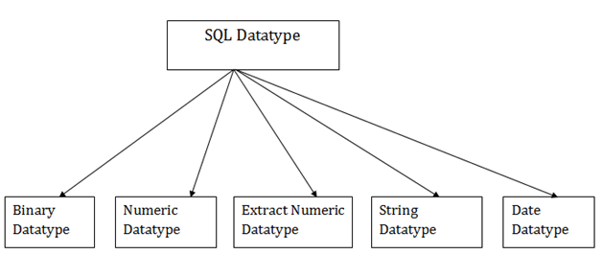
Types of Data Types
Like in other programming languages, SQL also has certain data types available.

Slide 4
Binary Data Types
There are Three types of binary Datatypes which are given below:
Data Type | Description
binary | It has a maximum length of 8000 bytes. It contains fixed-length binary data.
varbinary | It has a maximum length of 8000 bytes. It contains variable-length binary data.
image | It has a maximum length of 2,147,483,647 bytes. It contains variable-length binary data.

Slide 5
Approximate Numeric Data Type
The subtypes of this datatype are given in the table with the range.
Data type | From | To | Description
float | -1.79E + 308 | 1.79E + 308 | It is used to specify a floating-point value e.g. 6.2, 2.9 etc.
real | -3.40e + 38 | 3.40E + 38 | It specifies a single precision floating point number.

Slide 6
Exact Numeric Data Type
There are some subtypes which are given below in the table. The table contains the range of data in a particular type.
Data type | Description
int | It is used to specify an integer value.
smallint | It is used to specify small integer value.
bit | It has the number of bits to store.
decimal | It specifies a numeric value that can have a decimal number.
numeric | It is used to specify a numeric value.

Slide 7
Character String Data Type
The subtypes are given below:
Data type | Description
char | It has a maximum length of 8000 characters. It contains Fixed-length non-unicode characters.
varchar | It has a maximum length of 8000 characters. It contains variable-length non-unicode characters.
text | It has a maximum length of 2,147,483,647 characters. It contains variable-length non-unicode characters.

Slide 8
Date & Time Data Types
The subtypes are given below:
Datatype | Description
date | It is used to store the year, month, and days value.
time | It is used to store the hour, minute, and second values.
timestamp | It stores the year, month, day, hour, minute, and the second value.

Slide 9
Data Integrity in DBMS
Data integrity is the overall accuracy, completeness, and consistency of data. Data integrity also refers to the safety of data in regard to regulatory compliance and security. It is maintained by a collection of processes, rules, and standards implemented during the design phase.
When the integrity of data is secure, the information stored in a database will remain complete, accurate, and reliable no matter how long it’s stored or how often it’s accessed.

Slide 10
Importance of Data Integrity
The importance of data integrity in protecting yourself from data loss or a data leak cannot be overstated: in order to keep your data safe from outside forces with malicious intent, you must first ensure that internal users are handling data correctly. By implementing the appropriate data validation and error checking, you can ensure that sensitive data is never miscategorized or stored incorrectly, thus exposing you to potential risk.

Slide 11
Types of Integrity
Maintaining data integrity requires an understanding of the two types of data integrity:
Physical integrity
Logical integrity
Both are collections of processes and methods that enforce data integrity in both hierarchical and relational databases.

Slide 12
Physical Integrity
Physical integrity is the protection of the wholeness and accuracy of that data as it’s stored and retrieved. When natural disasters strike, power goes out, or hackers disrupt database functions, physical integrity is compromised. Human error, storage erosion, and a host of other issues can also make it impossible for data processing managers, system programmers, applications programmers, and internal auditors to obtain accurate data.

Slide 13
Logical Integrity
Logical integrity keeps data unchanged as it’s used in different ways in a relational database. Logical integrity protects data from human error and hackers as well, but in a much different way than physical integrity does.
There are four types of logical integrity:
Entity Integrity
Referential Integrity
Domain Integrity
User-Defined Integrity

Slide 14
Entity Integrity
The entity integrity states that primary key value can't be null.
This is because the primary key value is used to identify individual rows in relation and if the primary key has a null value, then we can't identify those rows.
A table can contain a null value other than the primary key field.

Slide 15
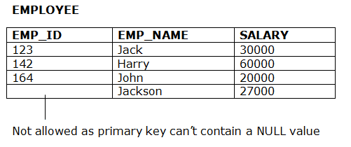
Example:

Slide 16
Referential Integrity
A referential integrity constraint is specified between two tables.
In the Referential integrity constraints, if a foreign key in Table 1 refers to the Primary Key of Table 2, then every value of the Foreign Key in Table 1 must be null or be available in Table 2.

Slide 17
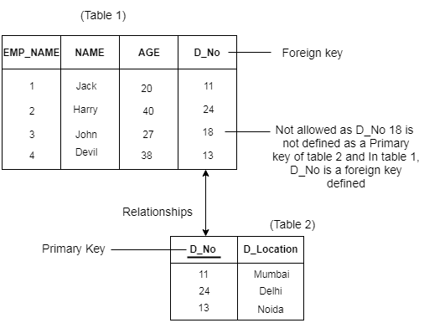
Example:

Slide 18
Domain Integrity
Domain integrity is the collection of processes that ensure the accuracy of each piece of data in a domain. In this context, a domain is a set of acceptable values that a column is allowed to contain. It can include constraints and other measures that limit the format, type, and amount of data entered.
The data type of domain includes string, character, integer, time, date, currency, etc. The value of the attribute must be available in the corresponding domain.

Slide 19
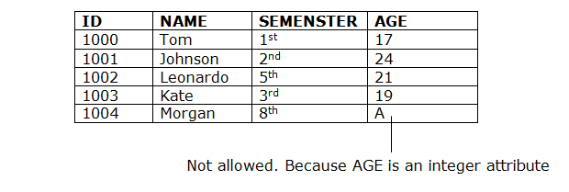
Example:

Slide 20
User-defined Integrity
User-defined integrity involves the rules and constraints created by the user to fit their particular needs. Sometimes entity, referential, and domain integrity aren't enough to safeguard data. Often, specific business rules must be taken into account and incorporated into data integrity measures.
Such integrity is typically implemented through triggers and stored procedures. Triggers are a block of statements which executes automatically if any predefined events occur.

Slide 21
Example:
Let us suppose we have an employee_table with attributes like emp_id, emp_name, job_name, salary, mobile_no. Here we have constraints that the id of an employee should always start with some specific characters like 'AfterAcademy' and then followed by digits. So, any entry which does not follow this constraint would not be acceptable.

Slide 22
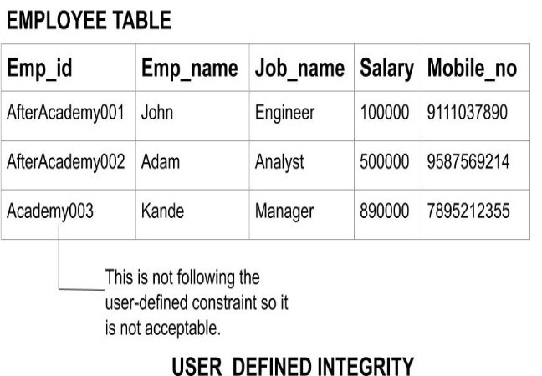

Slide 23
Data Integrity Risks
An collection of factors can affect the integrity of the data stored in a database.
A few examples include the following:
Human error: When individuals enter information incorrectly, duplicate or delete data, don’t follow the appropriate protocols, or make mistakes during the implementation of procedures meant to safeguard information, data integrity is put in hazard.

Slide 24
Transfer errors: When data can’t successfully transfer from one location in a database to another, a transfer error has occurred. Transfer errors happen when a piece of data is present in the destination table, but not in the source table in a relational database.
Bugs and viruses: Spyware, malware, and viruses are pieces of software that can invade a computer and alter, delete, or steal data.

Slide 25
Compromised hardware:
Sudden computer or server crashes, and problems with how a computer or other device functions are examples of significant failures and may be indications that your hardware is compromised. Compromised hardware may render data incorrectly or incompletely, limit or eliminate access to data, or make information hard to use.

Slide 26
Risks to data integrity can easily be minimized or eliminated by doing the following:
Limiting access to data and changing permissions to restrict changes to information by unauthorized parties
Validating data to make sure it’s correct both when it’s gathered and when it’s used
Backing up data
Using logs to keep track of when data is added, modified, or deleted
Conducting regular internal audits
Using error detection software

Slide 27
Thank YOU

